Slide 1

Analysis and Visualization For India Suicide Rate

Slide 2
About Me
My name is Shivendra kumar jha, currently persuing my b-tech from SRM Institute of Science And Technology Ramapuram. I’m a Logicplay Big Data Head and a COO at Myickart . I am currently exploring the field of Data Science through various measures. I Did number of projects on Data science and Machine learning. And These days, I’m focused on doing projects on the various Web development data analytics and machine learning techniques.

Slide 3
Objective : -
The nation accounts for over a third of the world's annual female suicides and nearly a fourth of male suicides, a significant rise in global share from 1990.
Each suicide is a personal tragedy that prematurely takes the life of an individual and has a continuing ripple effect, dramatically affecting the lives of families, friends and communities. Every year, more than 1,00,000
people commit suicide in our country. There are various causes of suicides like
professional/career problems, discrimination,sense of isolation, abuse, violence, family problems, mental disorders, addiction to alcohol, financial loss, chronic pain etc.
Study suicide rates for various locations in India.
Identify the major causes that contribute to the most of the suicide attacks in India.
Analyse Suicides attacks on the basis of means and status of victims.

Slide 4
What We are going to Talk :-
Various Data Analytics & Visualization using Python
Lib of python like :
Numpy
Pandas
Matplotlib
Seaborn
Etc

Slide 5
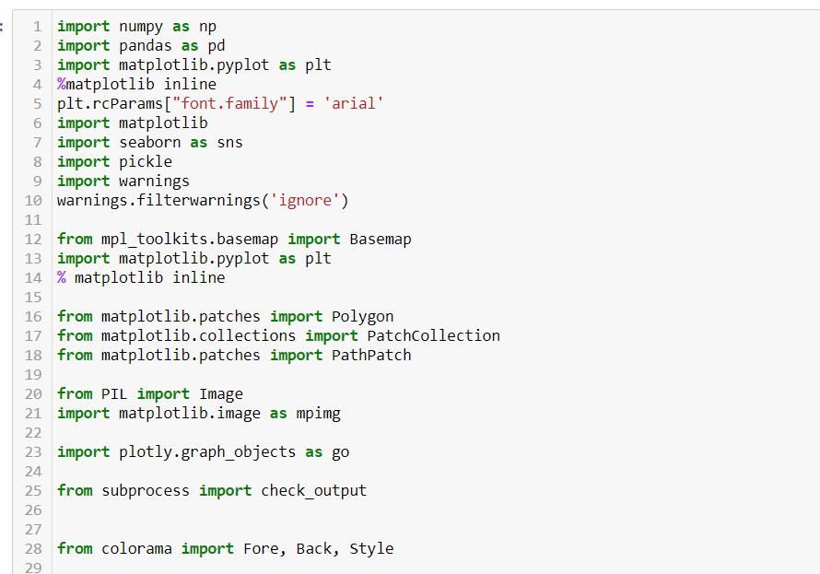
Importing all libraries

Slide 6
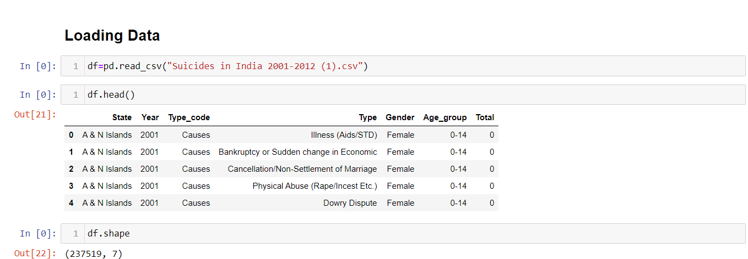
Loading Dataset for further Analysis and Visualization

Slide 7
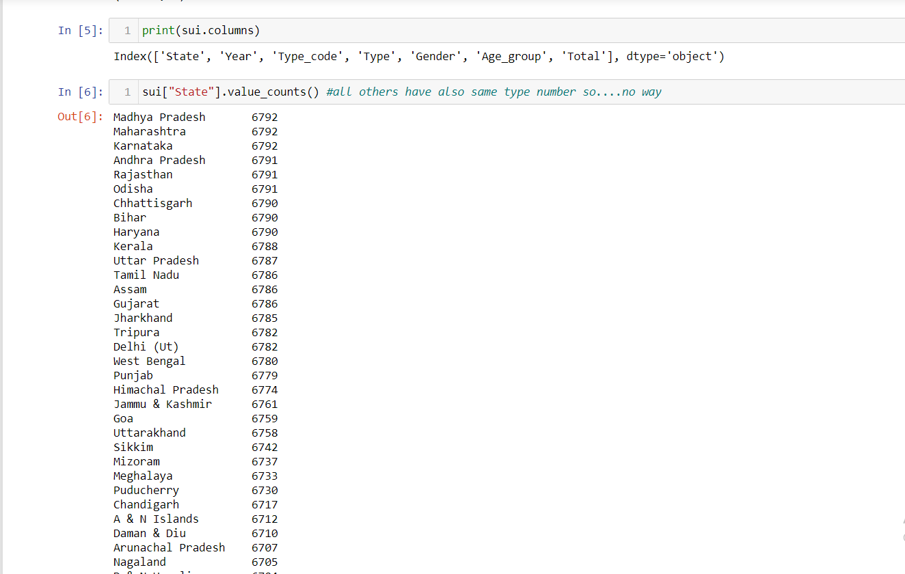
Statewise Value Count

Slide 8
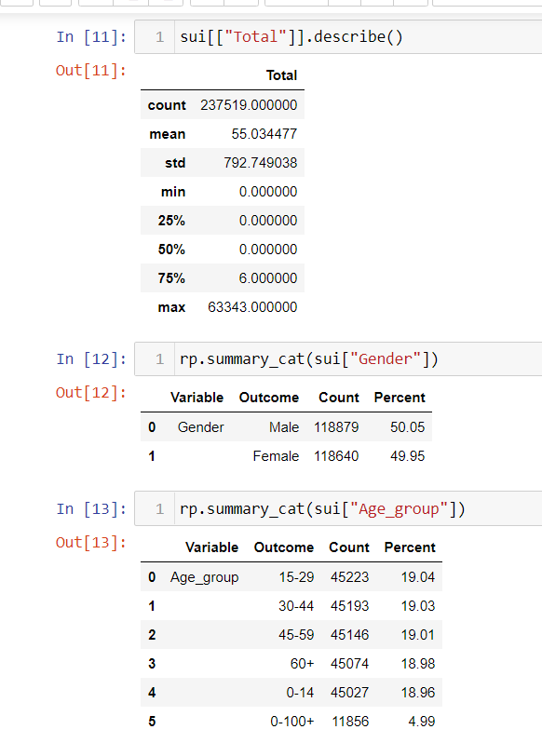
Describing Our DataSet

Slide 9
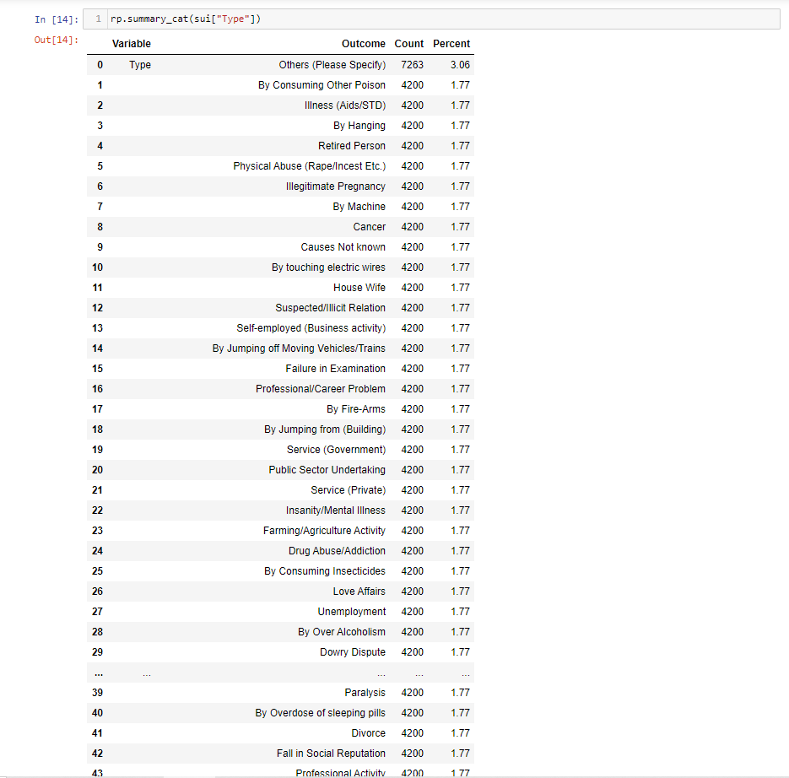
Reason For Suicide

Slide 10
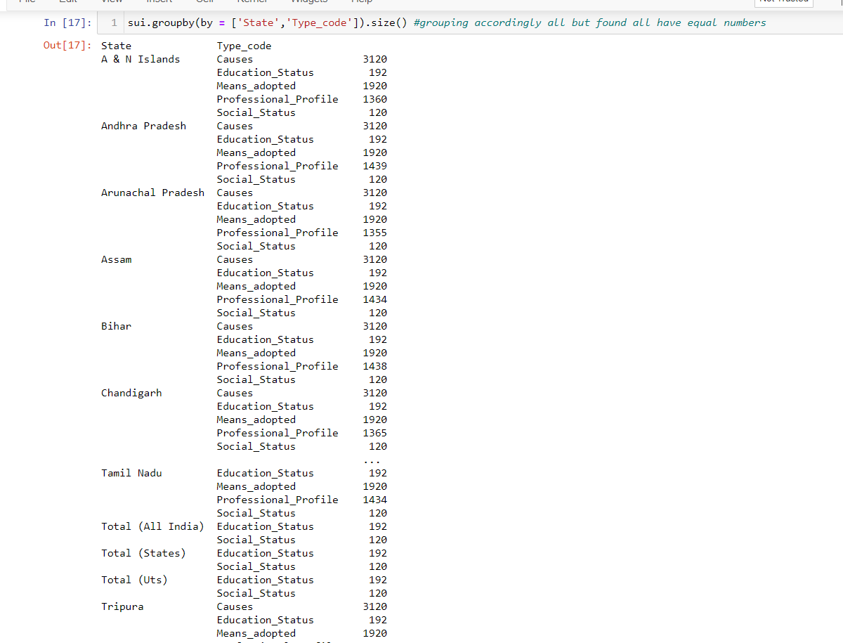
Statewise Reason For Suicide

Slide 11
Some Visualization on Dataset

Slide 12
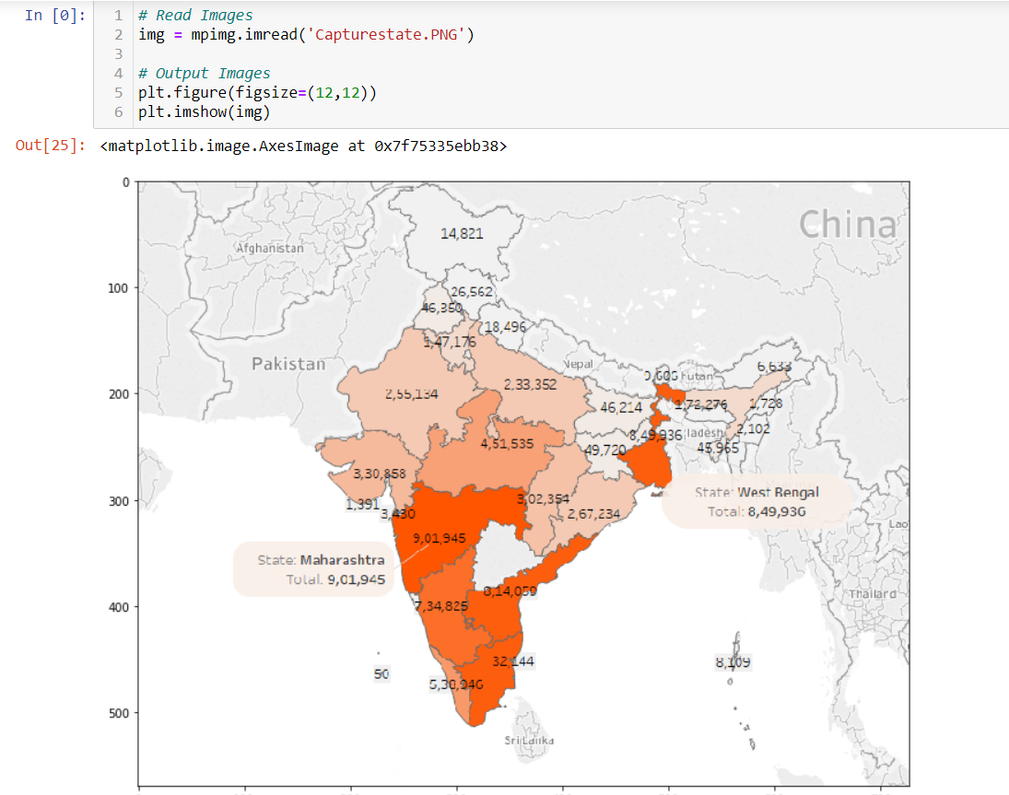
Number and Percentage Share of Suicides in States/Provinces

Slide 13
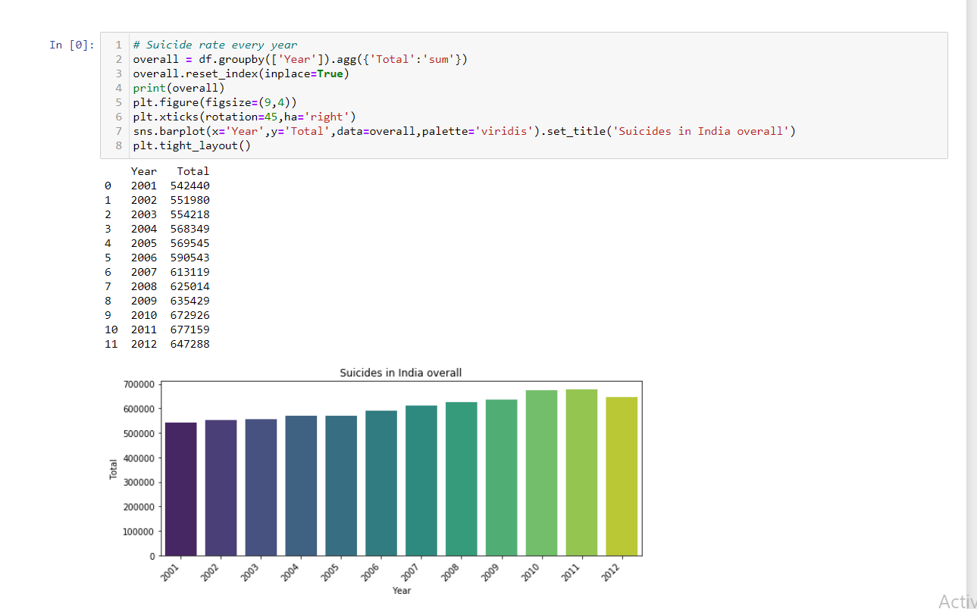
Year-wise Suicide Rate

Slide 14
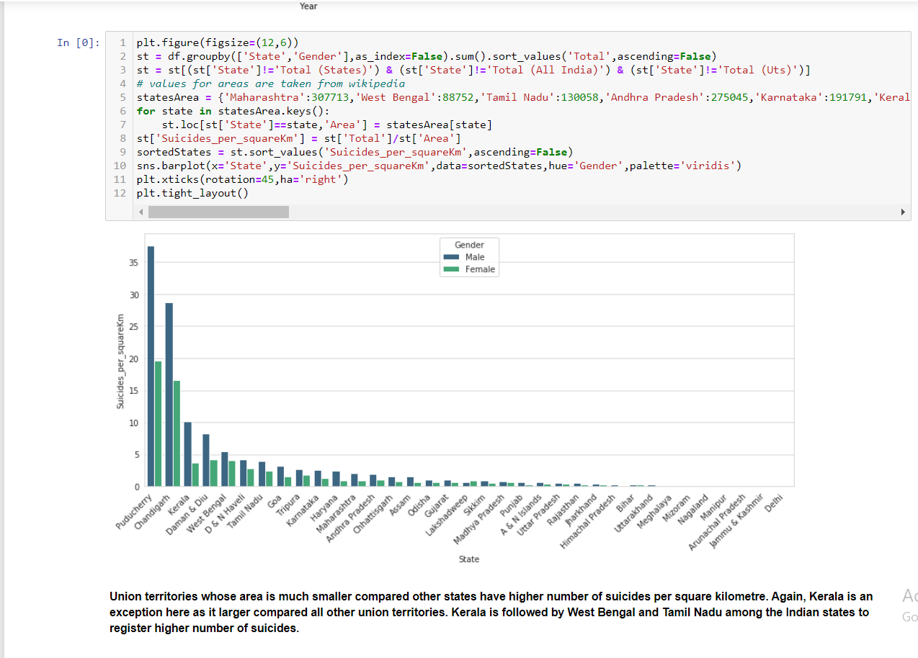
State-wise Graphical Representation

Slide 15
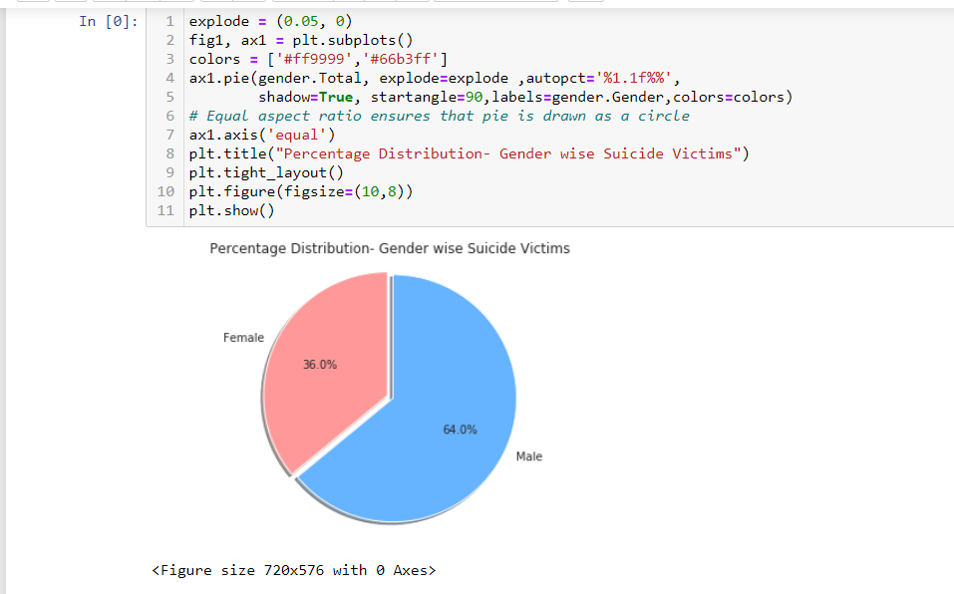
Ratio Of Suicide Rate

Slide 16
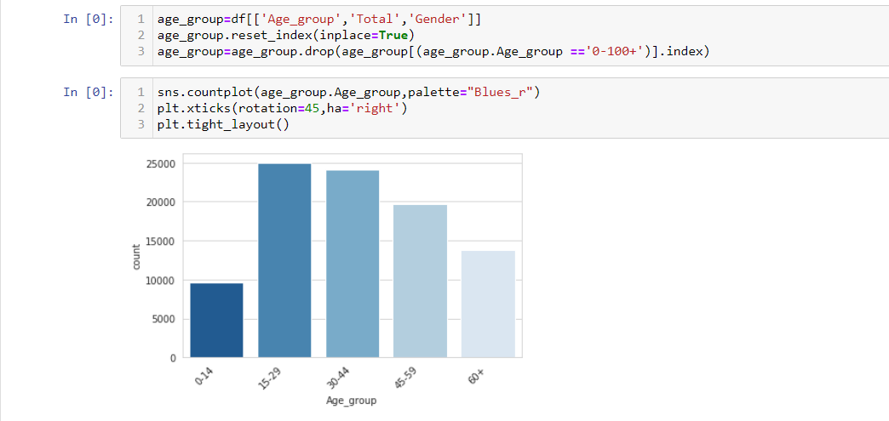
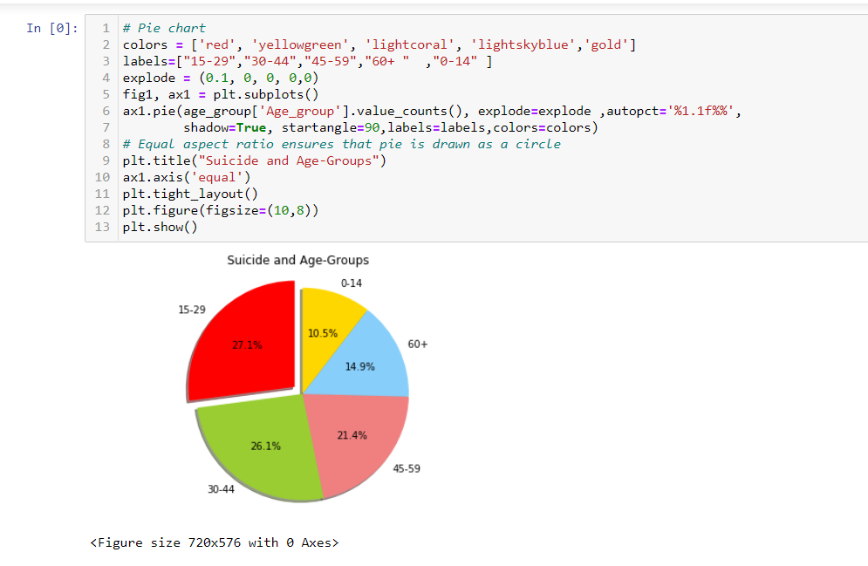
Which Age Make More Suicide

Slide 17
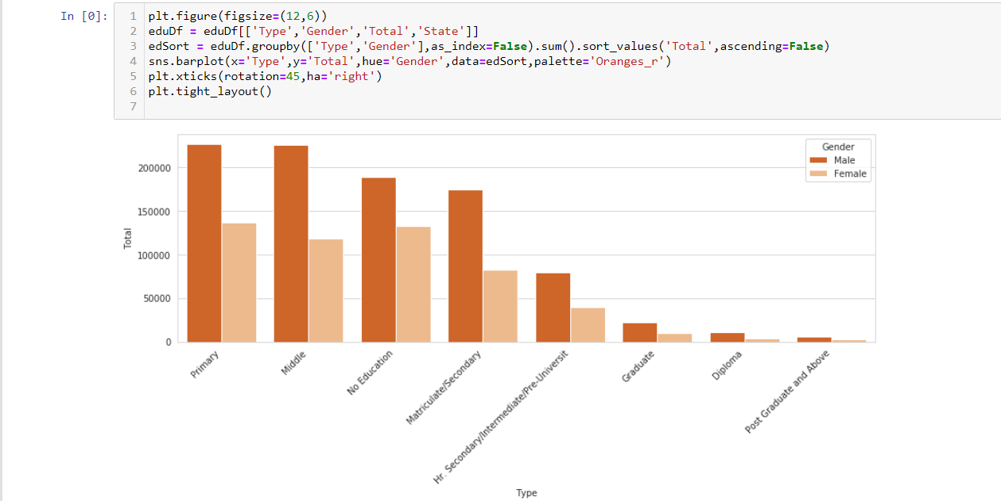
Education Level And suicide

Slide 18
## Conclusion
### Results
The summary of results about risk factors, means of suicides and profession of suicide victims
#### Results related to the risk factors for suicides
Males and Females up to 14 years’ age group commit suicide due to ‘Failure in examination’.
Males between age group 15–29 commit suicide due to ‘Failure in examination’ whereas Females within the same age group commit suicide due to ‘Love affairs’.
Males between age group above 30 commit suicide due to ‘Unemployment’, ‘Love Affairs’ and ‘Failure in examination’, while Females between the same age group are observed to commit suicide due to ‘Dowry Dispute’ and ‘Cancellation/Non-settlement of Marriage’.
Males and Females between age group 30–45 commit suicide due to ‘Family problems’ while Males between age group 45–60 commit suicide due to ‘Bankruptcy/sudden change in Economic status’ and ‘Poverty’.
#### Results related to means of suicides
Females between age group up to 14 years’ and 15–29 commit suicide by ‘Fire/self-immolation’, ‘Hanging’ and ‘Poisoning’.
Males between age group 30–44 commit suicide by ‘Hanging’, ‘Poisoning’ and coming under running vehicles/trains while Females commit suicide by ‘Fire/self-immolation’.
Males between age group 45–59 and above 60 years commit suicide by ‘Coming under running vehicles/trains’ and ‘Poisoning’ while Females above 60 years’ commit suicide by ‘Drowning’.
#### Results related to the profession of suicide victims
Male and Female with profession ‘Students’ up to age 14 and ‘Unemployed Males’ between age group 15–29 commit suicide.
Males with profession ‘Service’ between age group 30–44 and ‘House wife’ between age group 15–29, 45–59 and above 60 years’ age commit suicide.

